Slide 1
JSP Architecture
Prepared By,
Chirag K. Pujara

Slide 2
JSP Architecture
JSP architecture gives a high-level view of the working of JSP.
JSP architecture is a 3 tier architecture. It has a Client, Web Server, and Database.
The client is the web browser or application on the user side.
Web Server uses a JSP Engine i.e; a container that processes JSP. For example, Apache Tomcat has a built-in JSP Engine.
JSP Engine intercepts the request for JSP and provides the runtime environment for the understanding and processing of JSP files.
It reads, parses, build Java Servlet, Compiles and Executes Java code, and returns the HTML page to the client.
The webserver has access to the Database. The diagram on next slide shows the architecture of JSP.

Slide 3
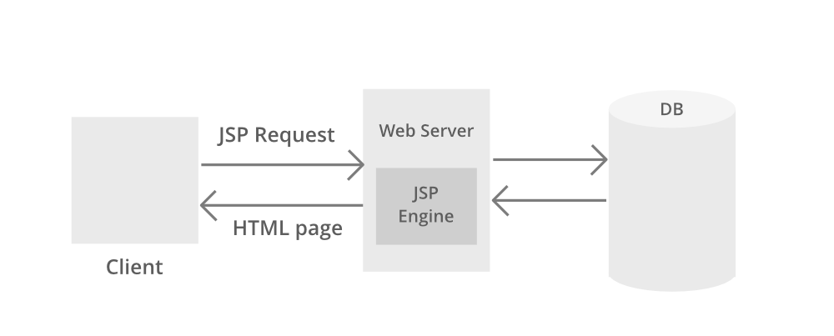
JSP Architecture

Slide 4
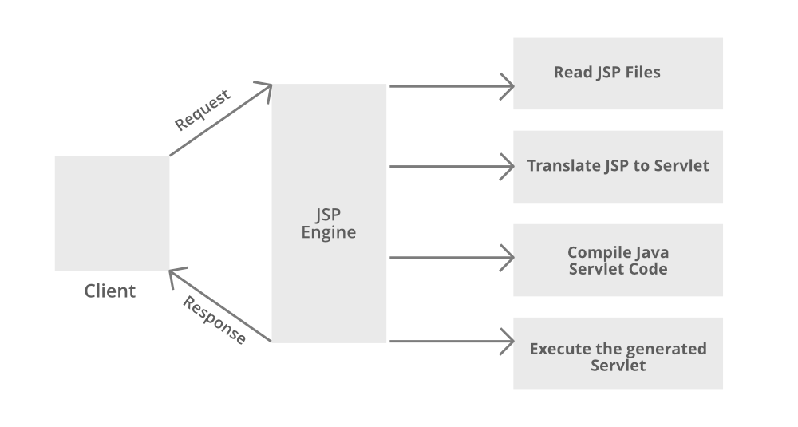
JSP Processing

Slide 5
JSP Processing Steps I
Step 1:
The client navigates to a file ending with the .jsp extension and the browser initiates an HTTP request to the webserver.
For example, the user enters the login details and submits the button. The browser requests a status.jsp page from the webserver.
Step 2:
If the compiled version of JSP exists in the web server, it returns the file.
Otherwise, the request is forwarded to the JSP Engine. This is done by recognizing the URL ending with .jsp extension.
Step 3:
The JSP Engine loads the JSP file and translates the JSP to Servlet(Java code).
This is done by converting all the template text into println() statements and JSP elements to Java code. This process is called translation.

Slide 6
JSP Processing Steps II
Step 4:
The JSP engine compiles the Servlet to an executable .class file.
It is forwarded to the Servlet engine. This process is called compilation or request processing phase.
Step 5:
The .class file is executed by the Servlet engine which is a part of the Web Server. The output is an HTML file. The Servlet engine passes the output as an HTTP response to the webserver.
Step 6:
The web server forwards the HTML file to the client’s browser.

